Slide 1
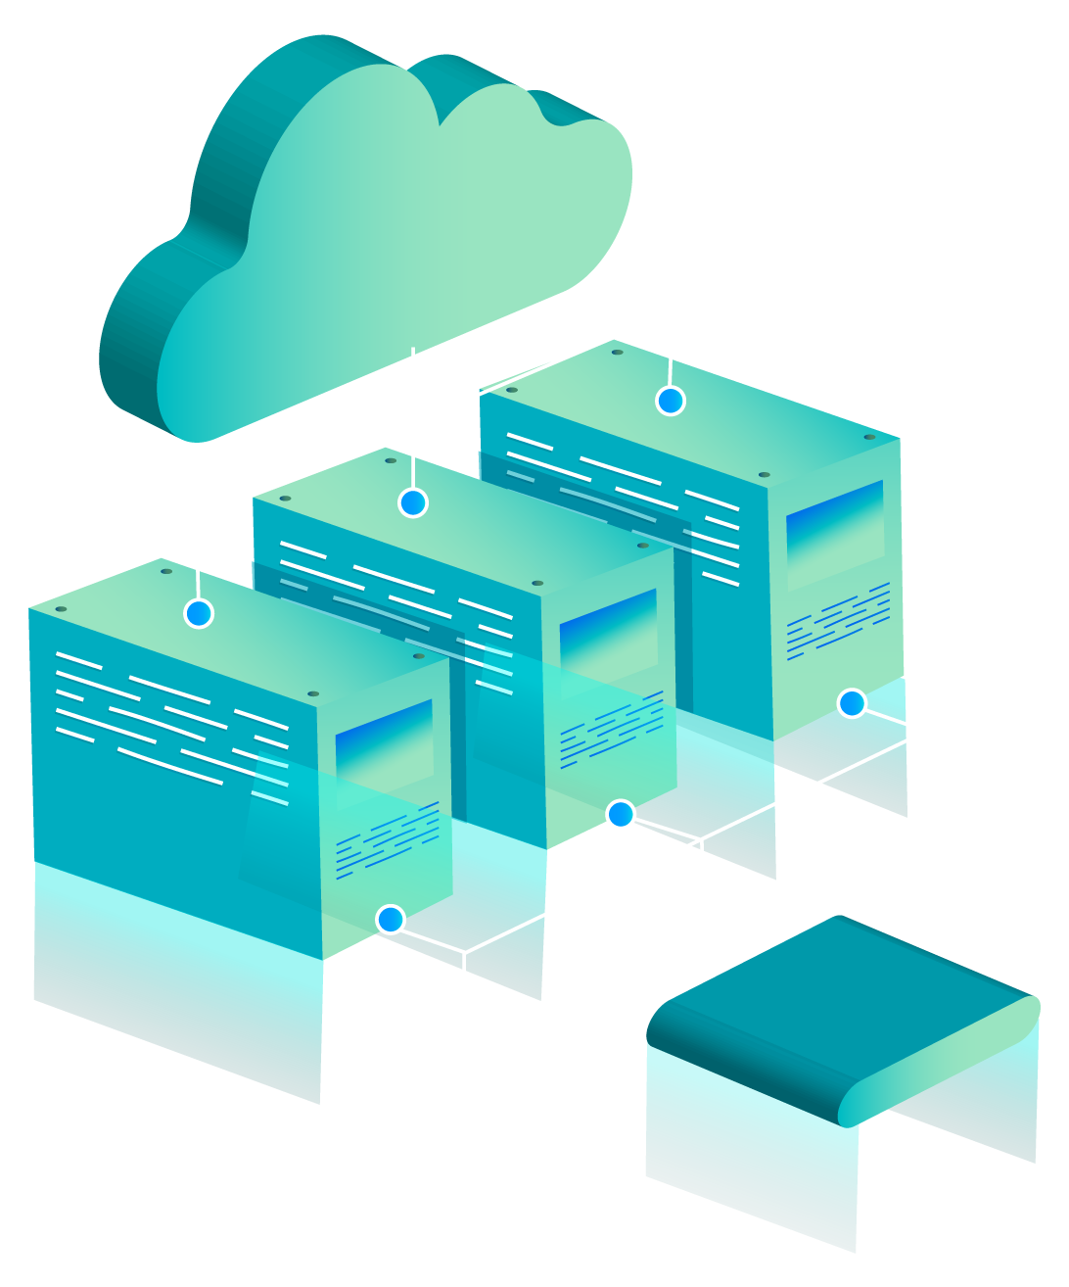
CLOUD City
Population: Alex Kelley, Noah Stiles, and Tanner Weinacker,

Slide 2
The pillars of the AWS Well-Architected framework
Operational Excellence
The ability to support the development and run workloads effectively, gain insights, and continuously improve processes
Security
Protect data, system, and assets
Reliability
Keeping a workload performing consistently and correctly
Performance Efficiency
using computing resources most effectively for your specific need
Cost Optimization
Creating a framework to deliver maximum efficiency at the lowest price point
Sustainability
Addressing the long-term environmental, economic, and societal impact

Slide 3
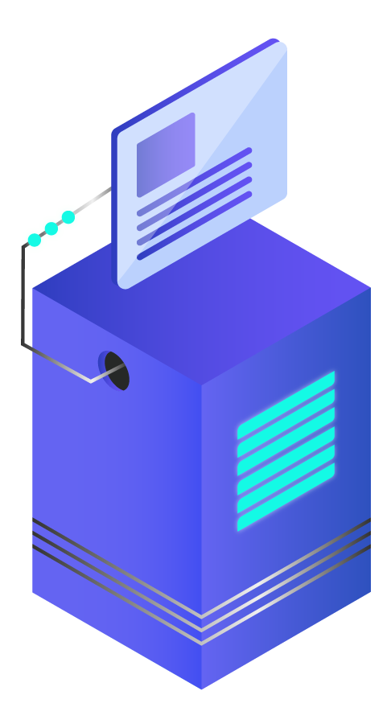
Executive Overview
In this project we have worked on implementing a cloud component to Champlain College. The integration of AWS into cyber.local to create one spot where user accounts, networks and billing are all centrally managed is fascinating. Everything will end up in the cloud at some point and so for our capstone, I wanted to explore/familiarize myself with it. We want to help to create an easier life for the faculty at Champlain College for all they have done for us. Although this project is not going into production. We hope our research, and testing will be the basis for Champlain's great transition to the cloud.

Slide 4
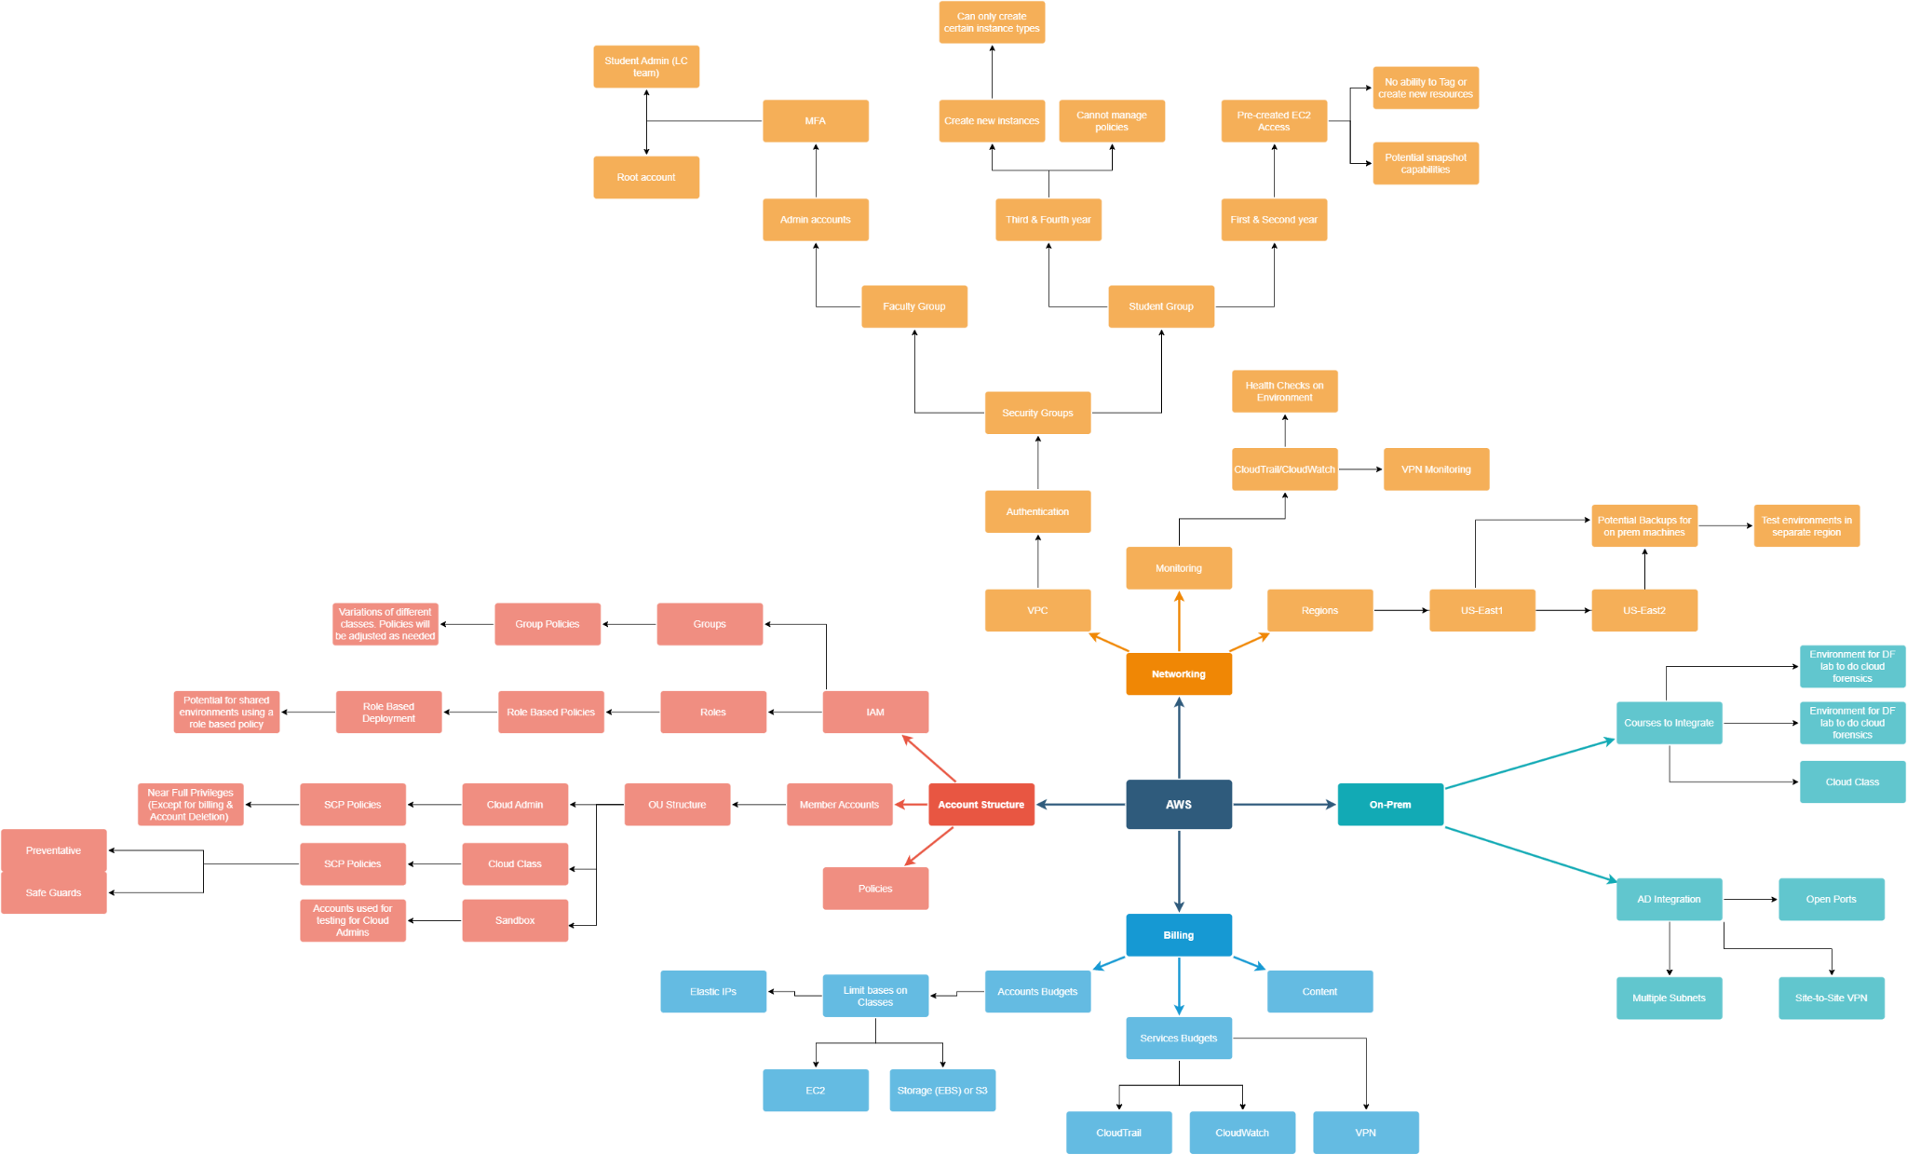

Slide 5
Abstract
Supply chain issues have affected the world in ways that have never been seen before Covid-19. From extended wait times to a lack of material, the supply chain has shown the world that it cannot handle being misaligned for even the smallest amount of time. Due to the pendulum swinging and no certainty of when the hardware will be delivered, cloud computing presents itself as a powerful solution.

Slide 6
Background & History
AWS History
Teams’ History
In 2003 Amazon had figured out they held a key advantage over their competitors. This advantage was their ability to manage and scale infrastructure reliably and effectively. This is how AWS was born. Within three years Amazon turned this idea into reality. In 2006 Amazon Simple Queue Service was launched which was then followed by S3, and EC2.
Alex, Tanner and I each took a cloud computing class with Professor Adam Goldstein during the Fall semester of our senior year. Within a few classes we became captivated by how vast AWS actually is. This then prompted our nerds cells that we need to master all 200 services

Slide 7
Research Phase

Slide 8
Onprem vs cloud costs
Cloud
On

Slide 9
The Fundamentals
Services
Documentation
AD Concepts
Services offered by AWS and their use within the network
The key to any good project is the documentation.
Prices, connectivity, and applying policies systematically.
Github
Notion

Slide 10
Creating an Organization
Policies
VPC
IAM
How we are going to secure the environment
Where we are going to be hosting our instances
Users, Groups, Roles

Slide 11
Budgeting
One extremely important thing was getting a control over spending so there wasn’t cost overruns for our clients. I spent the first few weeks getting budgets set up where it collated all of the costs, created automatic reports and overrun alerts.

Slide 12
Production Phase

Slide 13
Manual
To first learn the automation of AWS, I first needed to learn how to manually do the work. Within this point I created OUs, Policies, IAM users, Full AWS accounts, AD connections, VPCs and much more.
Every step of the way I had to properly document everything. This allowed me to return and review how to efficiently automate this process.
Documentation

Slide 14
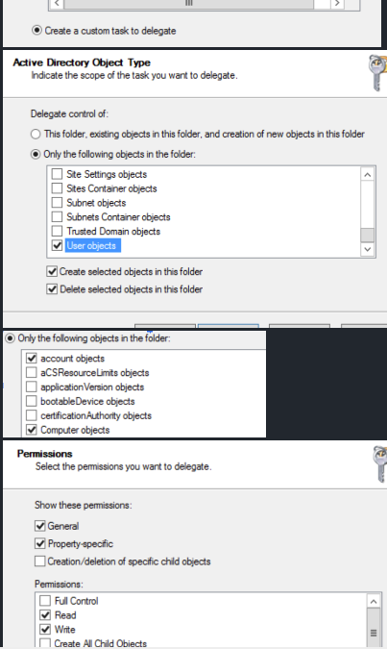
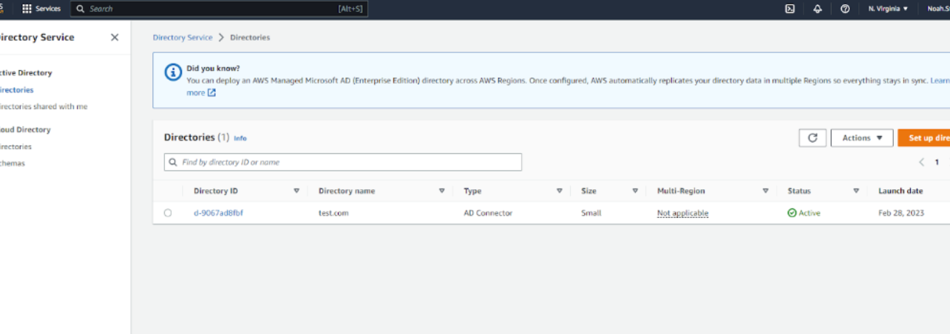
This is the least perms possible for AD connection
Here is the initial connection to the AD

Slide 15
Automation
User Creation
OU Creation
Ad Connector
This script, creates IAM users within a specified group. It also attaches a policy created within the script
View Script
This script, creates OUs, it has a nested option.
View Script
This script, connects an on premise AD to the cloud. It needs a service account but through Cloud Formation this is possible.
View Script

Slide 16
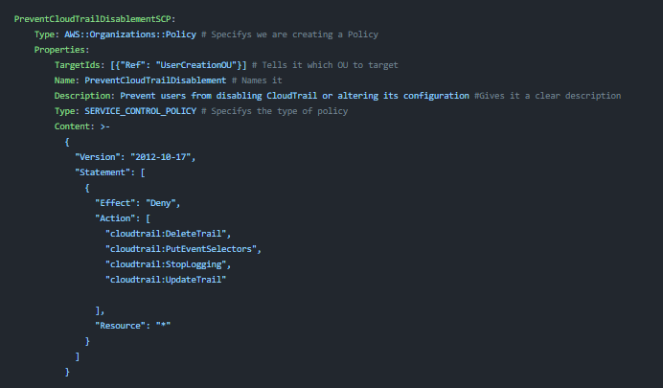
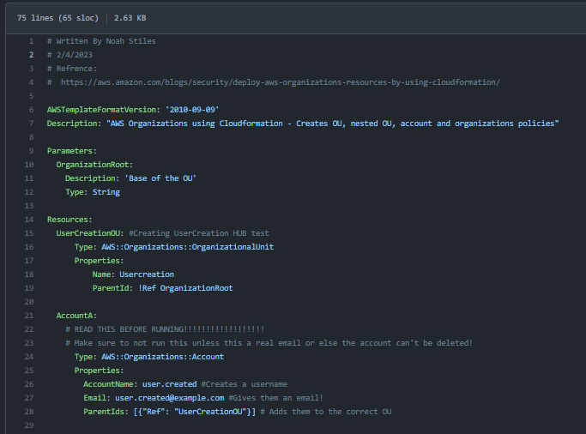
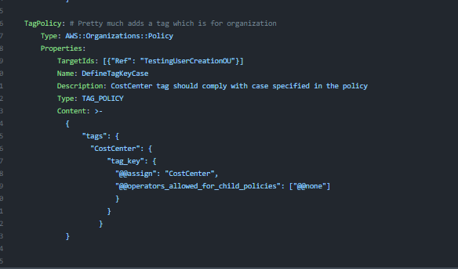
Altogether
This script combines OU Creation, account creation, and policy making.

Slide 17
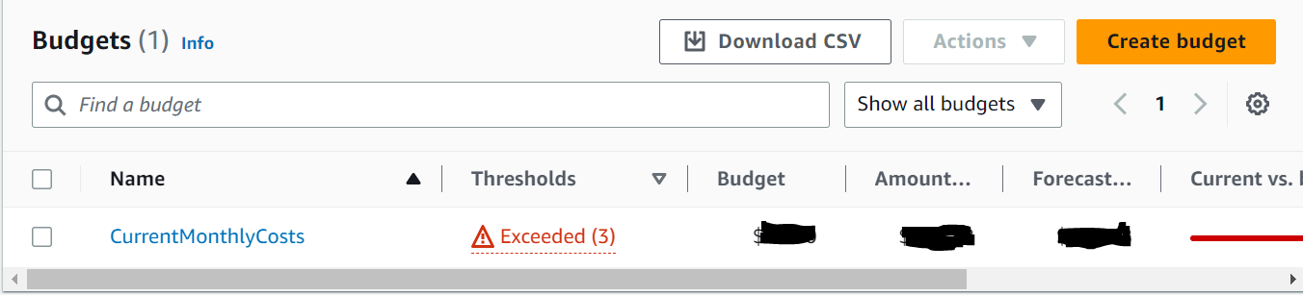
Budget controls
There are two main ways to implement budget controls
Json
Budget Service
{
"Version": "2012-10-17",
"Statement": [
{
"Effect": "Deny",
"Action": "*",
"Resource": "*",
"Condition": {
"NumericLessThan": {
"aws:PrincipalTag/costcenter": "(amount to limit too)"
}
}
}
]
}

Slide 18
OU Structure
Root
Cyber Admin
The top of the Organizational Structure
The Cloud Administrators
Cloud Class
Sandbox
Despite being red, Mars is actually a cold place
A testing environment for admins to test policies and various services

Slide 19
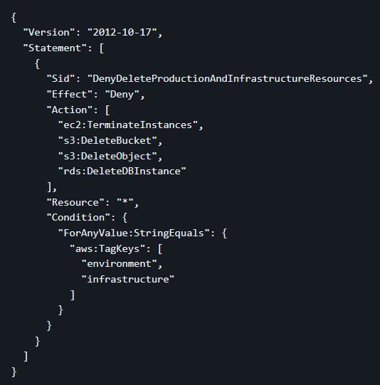
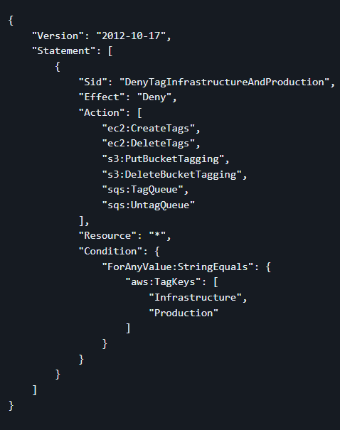
Sample Policies

Slide 20
Conclusion Phase

Slide 21
Overall
Although the project isn’t going into production. We have set the basis for a AWS team in the future. Our research and development will be passed down to future students to build a cyber.local cloud hybrid.
Currently we have a test environment with iam users, an Ad connection, and other features.

Slide 22
Problems encounter and resolutions

Slide 23
Separation of users
Problem:
Users were all able to see each other and this was the main part of our project
Solutions:
We were able to deploy an SCP to negate this
Further, we found separating users based on region works
As well as through policies

Slide 24
AD Least Level Perms allowed
AD Connector…Least level perms possible due to the fact it will be on essential equipment
Was able to achieve this through trial and error and research.

Slide 25
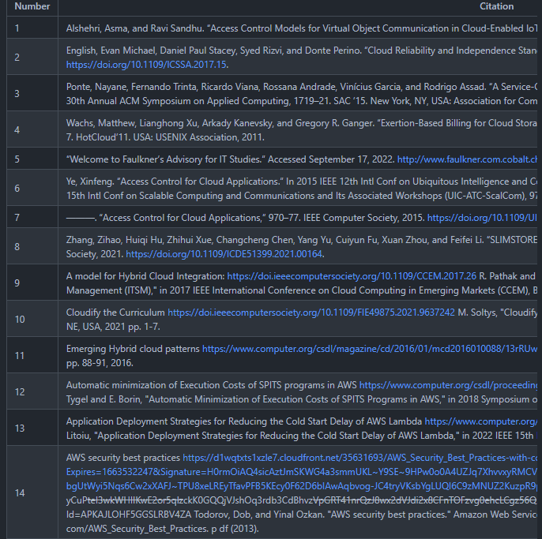
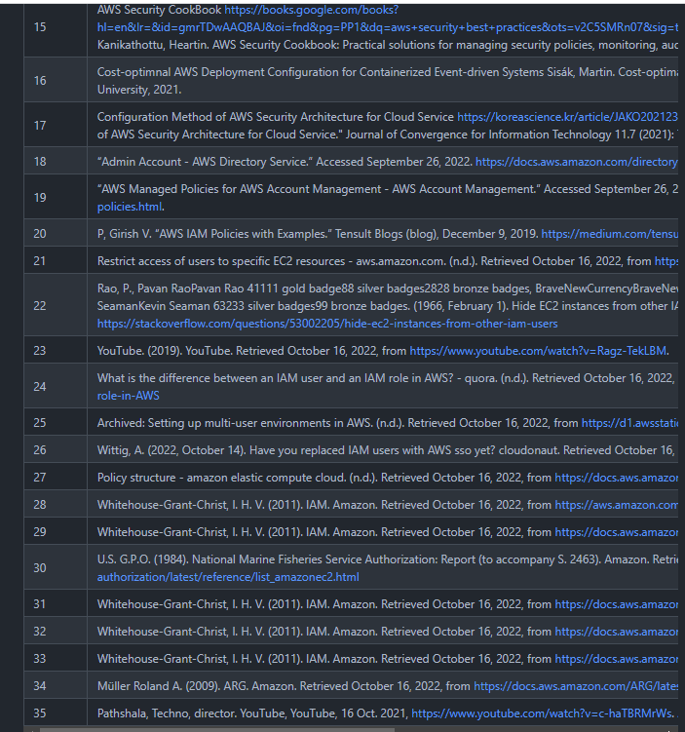
References
Link to Wiki

